Slide 1

HostelBuddy: Streamlining Hostel Management
Shashwat Singh Gaur
2201650109041 Kanpur Institute of Technology, Kanpur Dr. A. P. J. Abdul Kalam Technical University

Slide 2

Project Overview: HostelBuddy
Purpose
Problem Addressed
HostelBuddy is a desktop application designed to enhance efficiency in hostel management. It automates critical tasks such as student registration, room assignments, and reporting functions.
Traditional manual hostel systems often lead to errors, delayed updates, and poor resource tracking. HostelBuddy addresses these issues by providing a centralized, automated platform.
Technology Stack
Java Swing for UI
MySQL as backend database
NetBeans IDE for development
JDBC for database connectivity

Slide 3
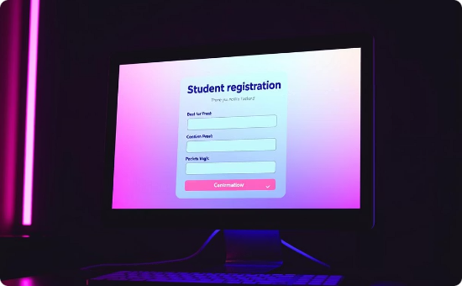
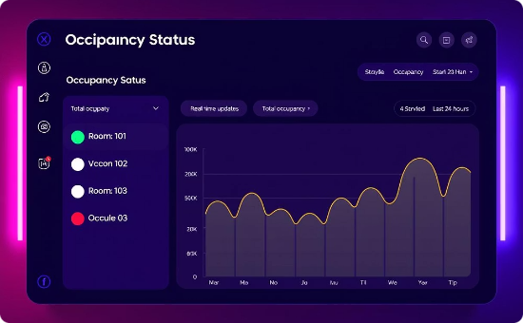
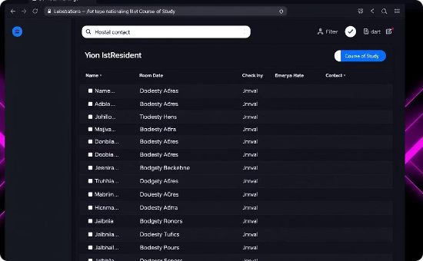
Core Features: Student Management
Student Registration
Status Tracking
Search & Filter
Collects detailed personal and contact information with validation to ensure accuracy and prevent errors.
Automatically updates student occupancy status as Living or Leaved for real-time record accuracy.
Powerful search features for quick lookup by name, ID, or room number, streamlining data retrieval.

Slide 4




Core Features: Room Allocation
Automated Assignment
Room Management
Real-Time Tracking
Define and manage room types, capacity, and rates with a visual hostel layout to improve management efficiency.
Occupancy updates in real-time to prevent overbooking and provide accurate data for billing and monitoring.
Advanced algorithms intelligently assign rooms based on availability, maximizing utilization and minimizing conflicts.

Slide 5
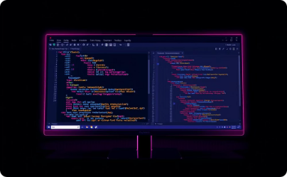



Technical Architecture
Java Swing
MySQL Database
JDBC Connectivity
NetBeans IDE
Implements a cross-platform graphical user interface using the MVC pattern, enabling modular code for easy maintenance and feature extensions.
Manages relational data including student profiles, room statuses, and transaction logs with normalized tables optimized for fast queries and scalability.
Provides an integrated environment with code completion, debugging tools, and deployment features to streamline Java application development.
Enables robust, secure database access with connection pooling, prepared statements, and efficient transaction management between Java applications and MySQL.

Slide 6
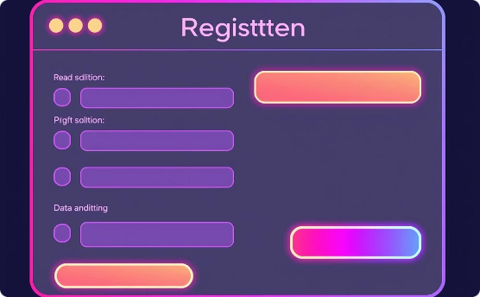
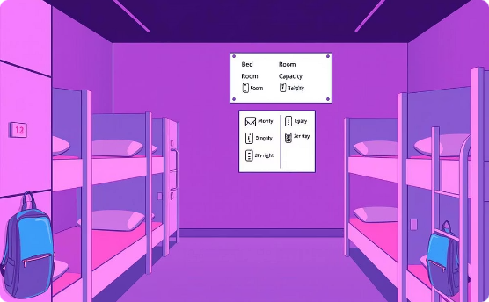
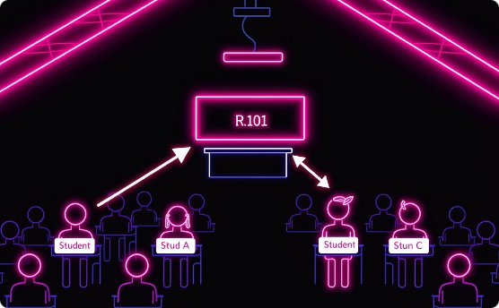
Database Design (MySQL)
Student Table
Room Table
Relationship
Stores all hostel residents' details with student_id (INT, primary key), full_name, date_of_birth, and contact info like phone_number and email_address. The room_id links to the Room Table, showing current accommodation. The status tracks occupancy ('Living', 'Leaved') for easy monitoring and history.
Lists all rooms with room_id (INT, primary key), room_number, room_type (Standard, Deluxe, Suite), capacity, and rate (DECIMAL) per occupant/month. This structure supports efficient allocation and clear billing.
A one-to-many relation links rooms and students: one room can house multiple students. The room_id foreign key in the Student Table references the Room Table's primary key. This design models shared accommodations and enables quick queries for occupants, vacancies, and reports.

Slide 7

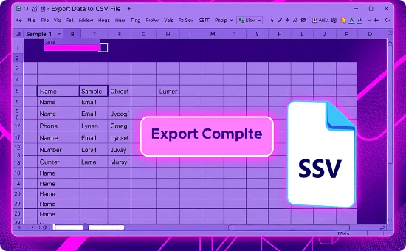
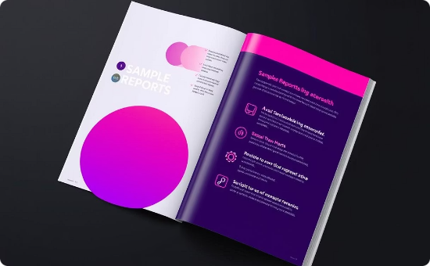
Reporting and Analytics
Custom Reports
CSV Export Utility
Sample Reports
Generate tailored occupancy and revenue reports with customizable filters such as date, room type, and status to analyze trends and optimize resource allocation.
Seamlessly export data to CSV format for integration with Excel, Google Sheets, and other analytics tools, supporting both batch and quick downloads.
Daily Occupancy Report
Monthly Revenue Overview
Student Directory
Room Maintenance Log
Late Payment Alerts

Slide 8
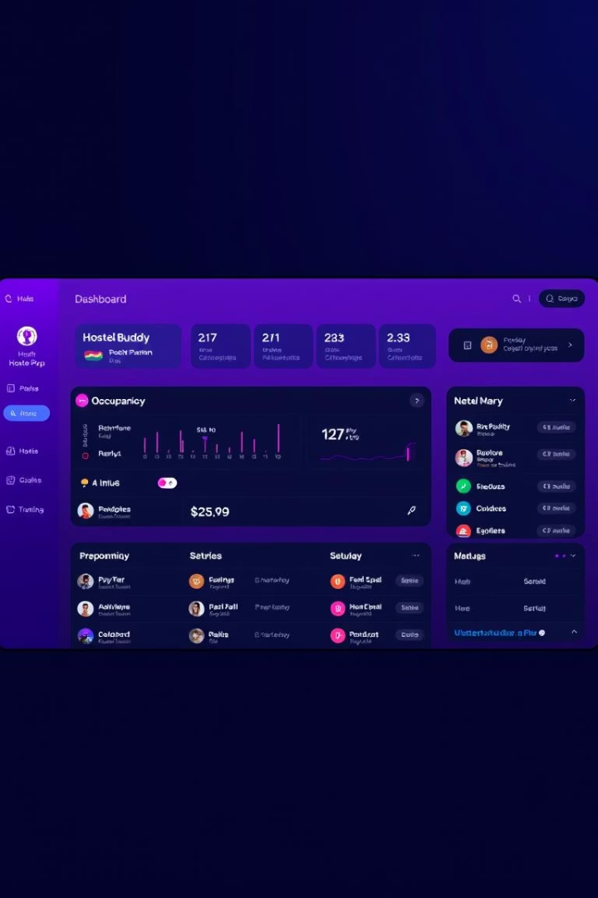



User Interface (Java Swing)
Intuitive Design
Form Validation & Error Handling
A clean, user-friendly dashboard offers quick access to key functionalities, enhancing user productivity.
Robust validation ensures no invalid data is submitted, preventing errors and application crashes.
Visual Occupancy Status
The interface visually displays real-time hostel occupancy, aiding quick decision-making and management oversight.

Slide 9




Challenges and Solutions
Database Connectivity
UI Responsiveness
Data Validation
Scalability
Created extensive validation rules to avoid invalid input and protect data integrity throughout the system.
Optimized database queries to efficiently handle growing data volumes without performance loss.
Implemented connection pooling to optimize and stabilize communication with MySQL for efficient data transfer.
Used multithreading techniques to keep the interface smooth and responsive during heavy data processing.

Slide 10




Conclusion and Future Enhancements
Project Summary
HostelBuddy effectively automates hostel processes, reduces manual workload, and improves data accuracy.
Future Plans
Develop a web-based version for remote access
Integrate payment gateways for online transactions
Add advanced analytics and predictive forecasting
Create a mobile app for student self-service
Thank You
We appreciate your interest and look forward to feedback and collaboration opportunities.

